Slide 1
Salary and Compensation Analysis Through Excel

Slide 2
Student Information
Name : Sandhiya
Register No :
Department : B.COM (General)
College : Ponnusamy Nadar College Of Arts and Science

Slide 3
AGENDA
Introduction
Project Overview
Objectives
Types
Features
Process
Conclusion

Slide 4
Introduction
EXCEL AIDS IN CONDUCTINS EMPLOYEE COMPENSATION ANALYSIS TO ENSURE THAT COMPENSATION PRACTICES ARE FAIR AND EQUITABLE ACROSS AN ORGANIΣΑΤΙΟΝ, COMPENSATION ARBETSIS WITHIN EXCEL PROVIDES DATA-DRIVEN INSIGHTS INTO SALARY BENCHMARKS PAT EQUITY ARE REMUNERATION PACKAGES, THERERY SUPPORTINGTRANSPARENCY AND FAIRNESS

Slide 5
Project Overview
Identify – The Data you Want
Collect - The Data
Clean - The data
Analyze - The Data
Interpret - The Result

Slide 6
Objective
For salary and compensation analysis in Excel, key data modeling objects include:
1. “Employee Table*: Employee ID, Name, Department, Role, Hire Date.
2. “Salary Table**: Base Salary, Bonus, Total Compensation, Last Raise Date.
3. “Benefits Table: Health Insurance, Retirement Contributions, Perks.
4. Job Grades Table**: Job Levels, Salary Ranges, Bonus Structures. 5. “Market Salary Table*”: External Benchmark Salaries.
Pivot Tables**: Summarize compensation by department, role, or level. 6. “
7. “Charts**: Salary distribution, compensation trends, comparisons.
8. **Scenario Analysis**: Model changes in compensation structures.

Slide 7
TYPES
Gathering employee data.
Calculating the average salary for each job title.
Dividing the total salaries by the number of employees with that title.
Comparing the compensation data across different job titles.
Evaluating and ensuring equitable pay structures.

Slide 8
Features
Step 1: Gather Employee Data. ...
Step 2: Calculate Average Salaries. ...
Step 3: Calculate Average Bonuses. ...
Step 4: Calculate Average Stock Options. ...
Step 5: Calculate Total Compensation. ...
Step 6: Compare Compensation Data.

Slide 9
Process
The process of.
1. Identifying a business problem
2. Finding data that will help solve this problem
3. Cleaning the data
4. Analyzing the data
5. Presenting the data

Slide 10
Data analytics process
Data isualization
Data interpretation
Data decision
Data collection
Data cleaning
Data analysis

Slide 11
Types of data analysis
Text analysis What happening?
Statistical analysis. What happened
Diagnostic analysis did a happen
Predictive analysis. What is likely to happen
Prescriptive analysis What action should we take

Slide 12
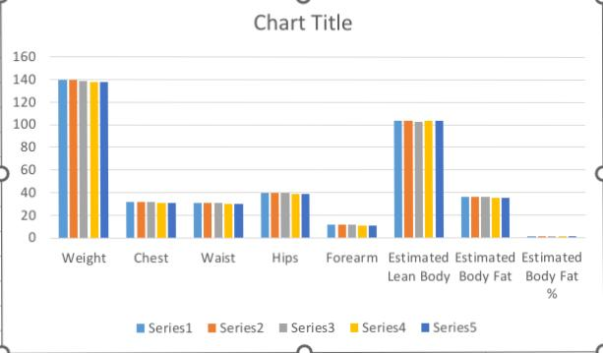
Results

Slide 13
Conclusion
Excel can be a useful tool for compensation analysis because it can help with:
Data organization: Excel can help you gather and organize employee data.
Calculations: Excel can automate calculations.
Market pay data: You can integrate market pay data from providers like SalaryCube.
Payroll processes: Excel can help streamline payroll processes.
Fair compensation practices: Excel can help you implement fair compensation practices.

